Slide 1



ITU ML-5G CHALLENGE
3D Location Estimation Using RSSI of Wireless LAN
Ndabuye S. Gideon
BSc. Software Engineering
Data Scientist, Cloud & AI Developer

Slide 2
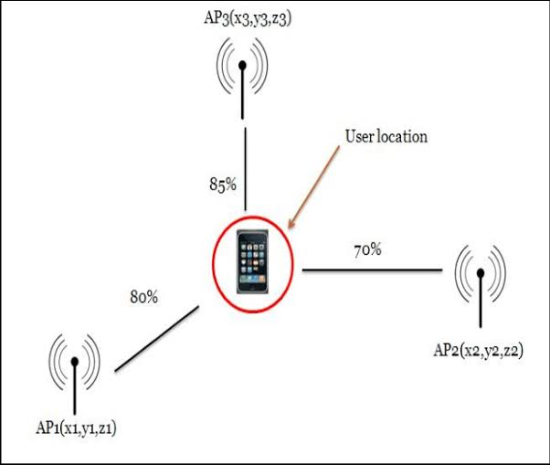
Introduction
Received signal strength indicator (RSSI) is a measurement of the power present in a received radio signal, invisible to receiver.
Wi-Fi is not designed for the purpose of positioning. However, signal strength from an AP imply the possibility of finding the location of the receiver
There is no direct mathematical formula to get a location from only this information.
We are going to employ various machine learning algorithms and evaluate how accurate they can be in estimating the position of a receiver in 3D.

Slide 3
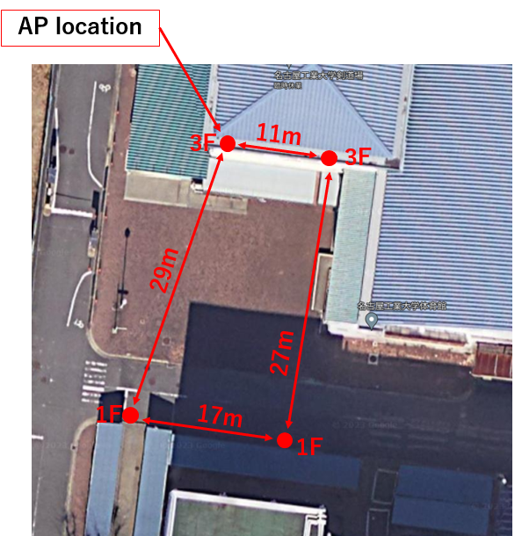
Introduction - Data
The data contains RSSI measured in dBm and other auxiliary information to estimate the 3D location of a receiver.
Information contained in the data.
RSS information from transmitters whose positions are known. (APs)
Information about the surrounding buildings such as RSSI measured with time stamp and SSID.
Time-series GPS data (Latitude and Longitude) of the transmitter
Channel setting, and map information of the measurement area to analyze LoS (Line of Sight)

Slide 4
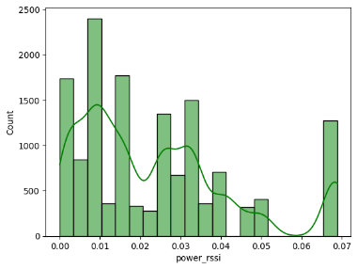
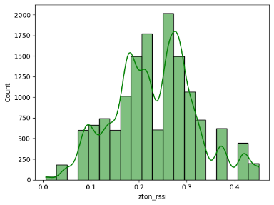
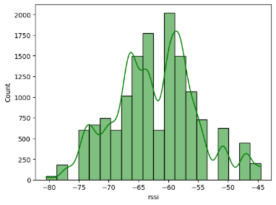
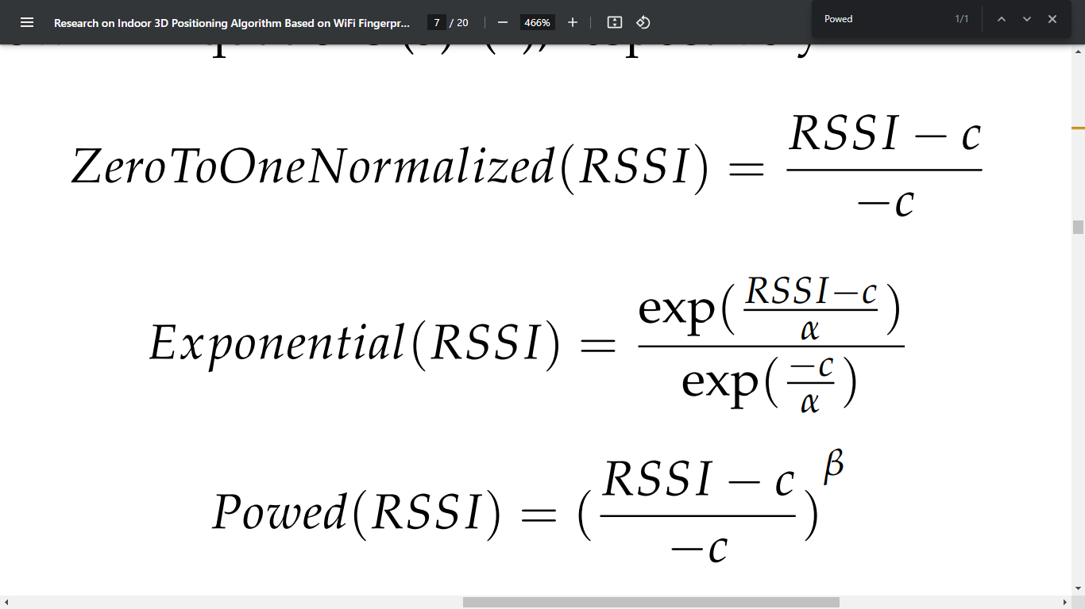
Proposed Solution
Data Preprocessing
RSSI
Common ranges: (-100 – 0/100) dBm
Our Data: -80 to -44
We need to transform the RSSI values to a more standard and well distributed way
Power Transformation
Zero to one Transformation
Original

Slide 5
Proposed Solution
Data Preprocessing
Access Points (APs)
Distances between all the available APs have information correlating with the RSSI and hence the info on the target location.
Time Series Info
Time series had range of 3 hours.
Difference in seconds or less is better useful, radio waves.
Lag of 1 step was used to match the records step. (1s)
This should give us some relationship with the Time of Arrival of the signal.
Miscellaneous
Pivoting the data on Channel and APs, to have RSSI w.r.t their channel and SSIDs respectively.
To ensure expected data range, the few outliers were replaced with the upper and lower boundaries.

Slide 6
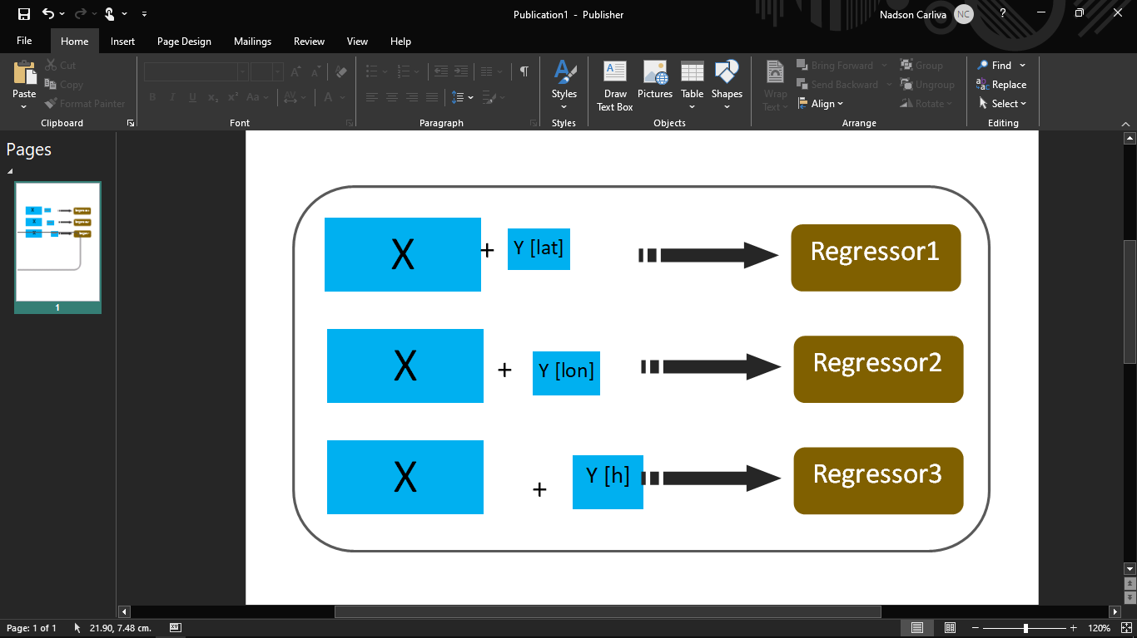
Proposed Solution
Modelling
HistGradientBoosting
Runs by binning features.
The nature of the data supports this, we have very few unique values in every column. Freq, Bandwidth, etc.
Stratified KFold
+
One batch Train

Slide 7
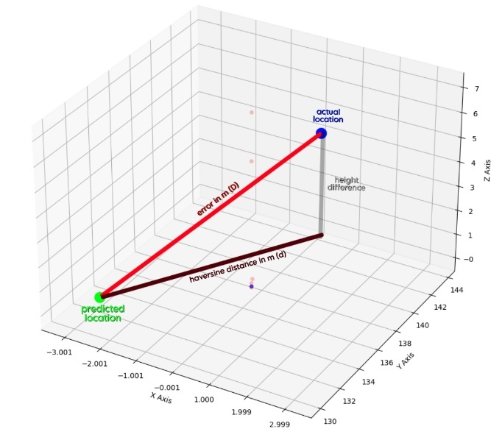
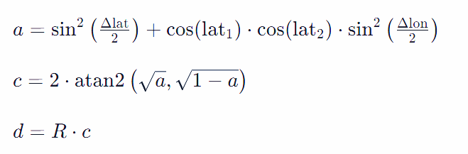
Proposed Solution
Evaluation
Evaluation of the model’s predictions were done in the localization error in meters (m), in 3D space.
Done in two steps
Calculate 2D Haversine distance (R=6,378,137m)
Pythagoras theorem to get the actual 3D distance (hypotenuse).

Slide 8
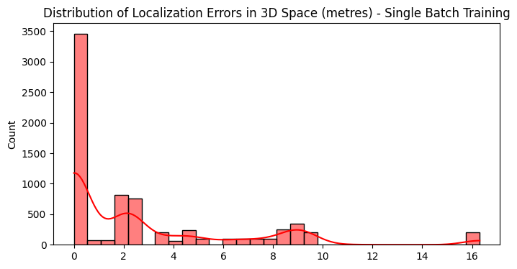
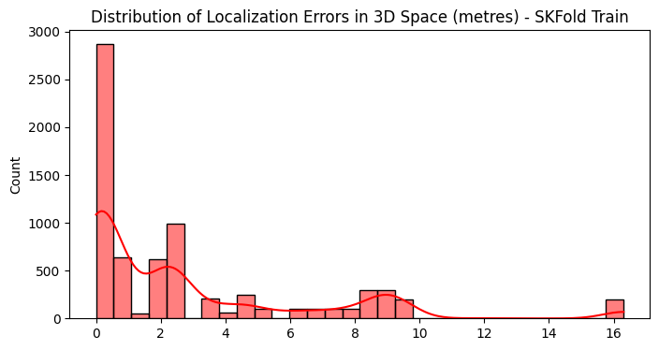
Results - Preliminary
Train Size: 7100
Test Size: 7200
Train Mode | Average Error (m) | Max Error (m)
Single Batch | 2.7244 | 16.3086
6 Stratified Fold | 2.8285 | 16.3086
Although we can clearly see more errors fall on a region below 1 meter, we can still see significant count of errors on 2 and between 6 and 10, and 16.
So, we need more data samples for this.

Slide 9
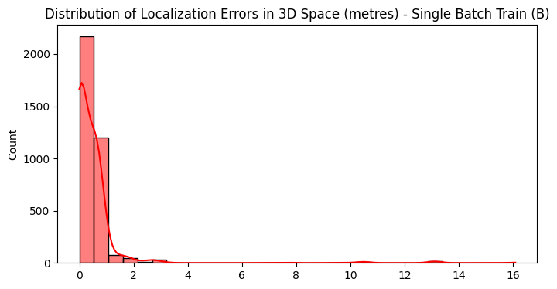
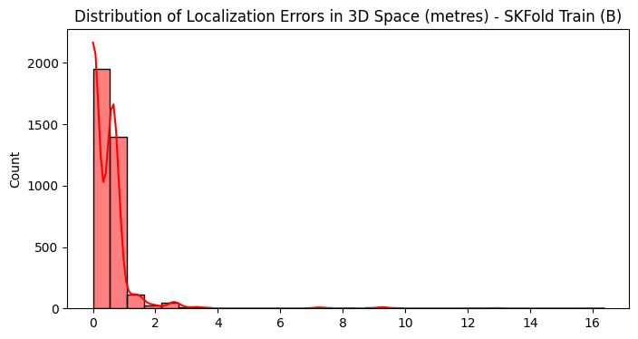
Results - Preliminary
Train Size: 10,725
Test Size: 3575
Train Mode | Average Error (m) | Max Error (m)
Single Batch | 0.53643 | 16.06050
6 Stratified Fold | 0.47332 | 16.05676
Now we see very more samples where errors are below 2 meters. Here, we can conclude that, a little more samples can give us more precise estimations

Slide 10
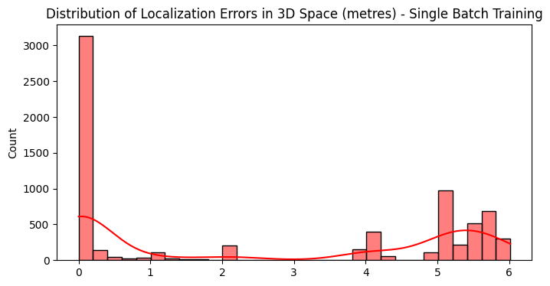
Results - Final
Final Train (100%)
Final Test (100%)
We see a better performance on the new sets.
Improved both average and maximum error
Showing the robustness of our approach.
Train Mode | Average Error (m) | Max Error (m) | RMSE (m) | Max Square Error(m2)
Single Batch | 2.58441 | 6.01505 | 3.57108 | 36.02232

Slide 11
Conclusion
In conclusion, this work addresses the challenge of precisely determining the three-dimensional location in WLAN.
The key contributions being, data preprocessing, where RSSI values are transformed for better model performance, and the incorporation of distances between access points (APs) to provide additional context for the model. Time series information and outlier handling.
The choice of the HistGradientBoosting algorithm as the base estimator in a multi-model regression framework due to nature of the data proved effective.

Slide 12
Thank you
Ndabuye S. Gideon
BSc. Software Engineering
Data Scientist, Cloud & AI Developer

